Slide 1

BUSINESS ANALYTICS CLUB
Workshop Series 10.17
Excel Solver
& Google Ads
Samantha Rettie
Shantanu Joshi

Slide 2
Learning Objectives
Learn the basics of Excel Solver and linear programming
Understand search engine advertising, costs per click, and second price auctions
Apply solver techniques in evaluating ideal bid placement for an online advertising campaign

Slide 3
Excel Solver
• Excel Solver is an add-in within excel that uses techniques from operations research to find optimal solutions to decision problems

Slide 4
Setup

Slide 5
Setup
• In order to use Excel Solver you must have either a windows
computer with Excel installed or a Mac Office 2011 and above
• If you do not have the correct office version for mac please see
appendix for Citrix set-up instructions

Slide 6
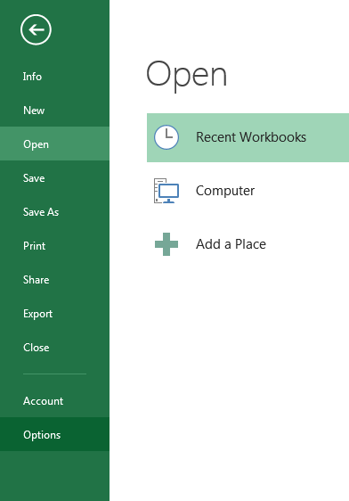
Windows Users
On the [File] tab, click [Options]

Slide 7
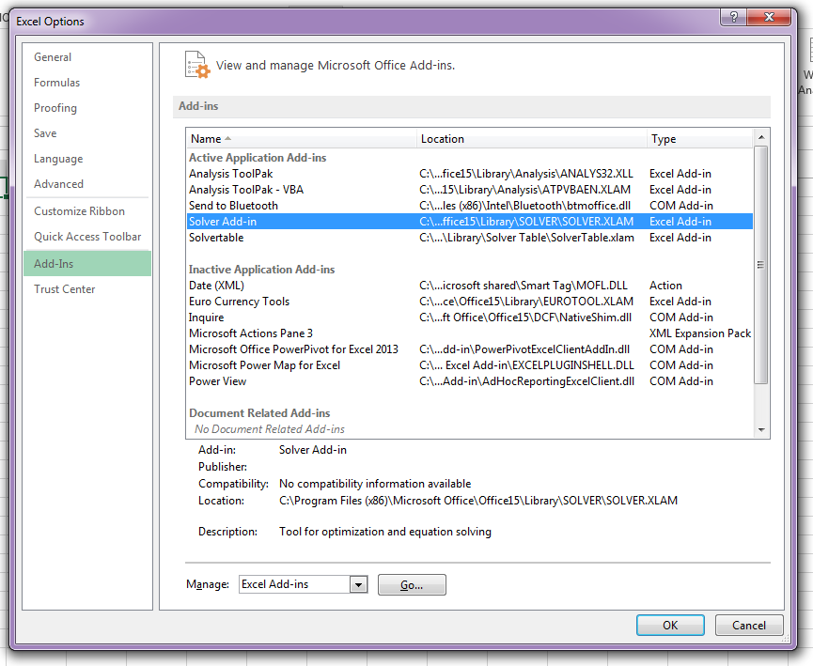
Windows Users
2. Under [Add-ins] select [Solver Add-in] and click [Go]

Slide 8
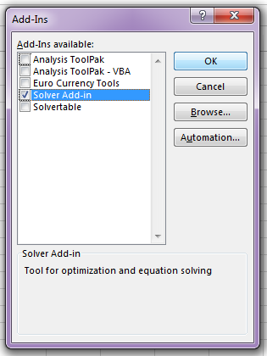
Windows Users
3. Make sure [Solver Add-in] is checked and click [OK]

Slide 9
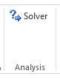
Windows Users
4. Under the [Data] tab you should see a button [Solver]

Slide 10
Mac Users
Note: this tutorial is for mac users with Office 2011 or above
1. Under the [Tools] menu click on [Add-Ins…]

Slide 11
Mac Users
2. Select the box for [Solved Add-In] and click [OK]

Slide 12
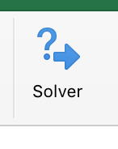
Mac Users
3. Under the [Data] tab a solver button should be visible

Slide 13
Linear Programming with Solver

Slide 14
Lego Furniture
• We are a furniture manufacturing company that builds furniture using LEGOs
• Our available resources include 6 (large) orange blocks and 8 (small) green blocks
• Operation costs are zero, we can make chairs and tables
• Tables sell for $16 and require 2 green + 2 orange blocks
• Chairs sell for $10 and require 2 green + 1 orange block

Slide 15
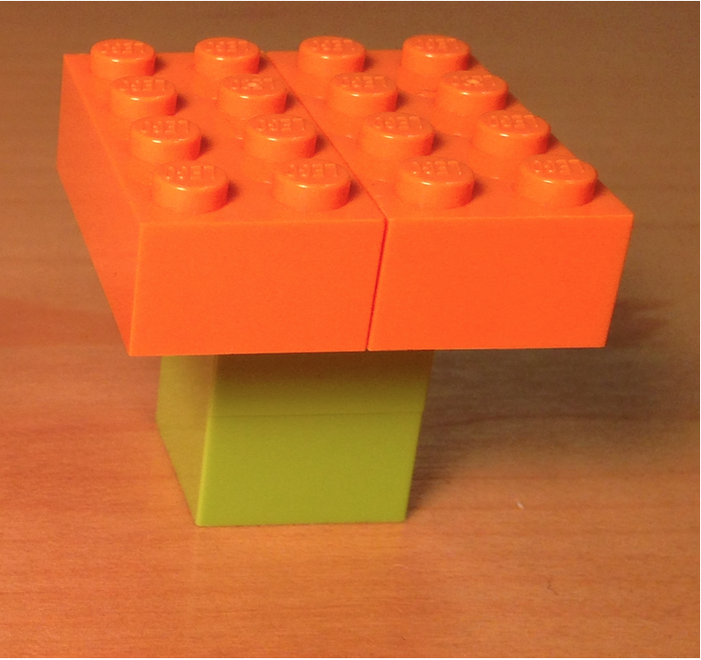
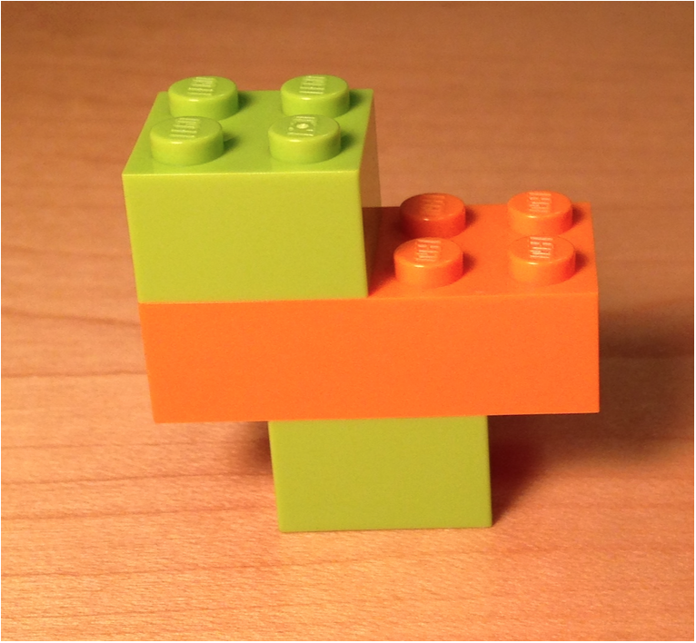
Lego Furniture
Table
sell for $16
requires:
2 green + 2 orange
Chair
sell for $10
requires:
2 green + 1 orange

Slide 16
Assuming everything we make will be sold…
How should we operate our production to maximize profits?

Slide 17
Possible Approaches
Algebraic Process
Collect given information
Write out formulas
Find objective
Maximize
Solve w/ Mathematical & Graphical Method
Find optimal corner
Solver Process
Define Decision Variables
Create Objective Function
Set Constraints

Slide 18
Algebraic Approach

Slide 19
Algebraic Approach
Algebraic Process
Collect given information
Write out formulas
Find objective
Maximize
Solve w/ Mathematical & Graphical Method
Find optimal corner

Slide 20
Algebraic Approach
x - # of chairs being made
y - # of tables being made
Objective: Max Profit
Maximize 10x + 16y
Restrictions:
2x + 2y ≤ 8 – # of green blocks used
x + 2y ≤ 6 – # of orange blocks used
x, y ≥ 0 – non-zero variables

Slide 21
Algebraic Approach
(3,0)
(0,0)

Slide 22
Algebraic Approach
(3,0)
(0,0)
The optimal solution is the corner point which maximizes our profit

Slide 23
Excel Solver Approach

Slide 24
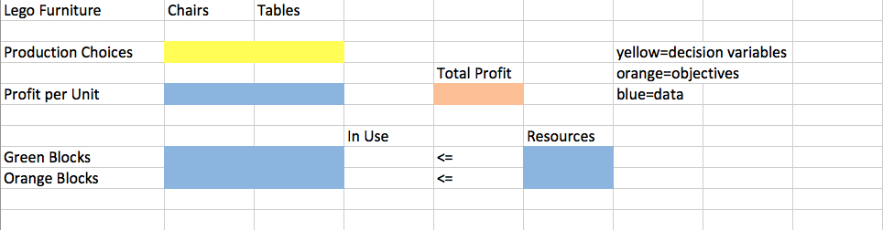
Solver Approach
Let’s fill in the Template File [Lego Furniture.xlsx]

Slide 25
Solver Approach
Decision Variables:
x - # of chairs being made
y - # of tables being made
Objective Function:
Max(10x + 16y)
Constraints:
2x + 2y ≤ 8 – # of green blocks used
x + 2y ≤ 6 – # of orange blocks used
x, y ≥ 0 – non-zero variables
Plug in the variables, click solver, and enter in your constraints…

Slide 26

Solver Solution
Solver has found THE optimal solution with 2 chairs and 2 tables

Slide 27
Search Engine Advertising

Slide 28
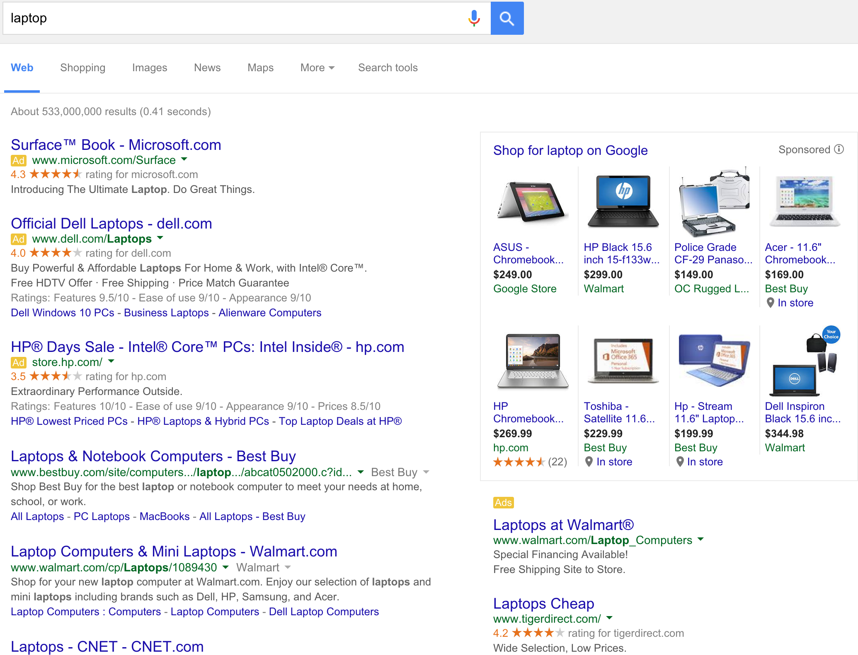
Google Advertising

Slide 29
Google Advertising
• Search engines have organic search results and sponsored
advertisements
• Google sells ad spaces through an auction system
• Advertisers bid on ad spaces in the form of $/click

Slide 30
Second Price Auctions
• Google auctions space using a
second price auction
• In a second price auction you
will pay the price of the bidder
you displace
• Example: If I bid $11, my ad will
be placed in Slot 2 and will cost
only $10
Ad-Slot | Highest Bid $/Click
1 | $12
2 | $10
3 | $4
4 | $2
5 | $0.40
6 | $0.29
7 | $0.023
8 | $0.01

Slide 31
Today’s Case

Slide 32
Google Ad Bidding
• You are running a campaign for a Refurbished Laptop website
• In order to advertise, you must get high ad placement against
competitors for the following keyword slots: “Laptop”,
“Refurbished Laptop”, “Cheap Laptop”, and “Used Laptop”
• Overall goal is to maximize clicks given Ad budget

Slide 33
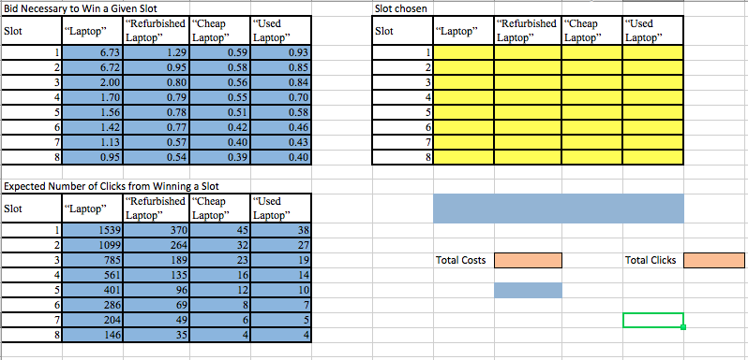
Template
Let’s fill in the Template File [Ad Bidding.xlsx]

Slide 34
Given Information
• Daily Budget is $550
• First table in template is # expected clicks per slot+keyword
• Second table is cost per click for given slot+keyword
• Third table is blank for determining which keyword and which slot
to take

Slide 35
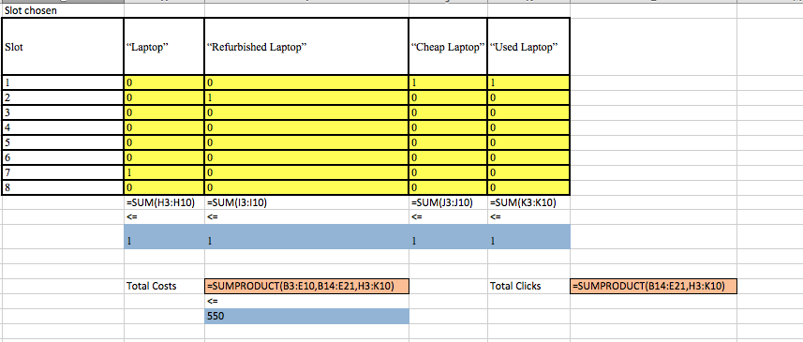
Solution

Slide 36
More Practice

Slide 37
Café Work Schedule
• Situation: You manage a café where every week you must
schedule which employees work which days
• Due to capacity issues only one employee can work per day
• As manager you want to make employees happy, find the best
way to maximize their happiness with your work schedule given a
measure of their preferences.

Slide 38
Preferences Schedule
• In order to be fair, the days must be split evenly between the Employees (each Employee works 2 days)
• A rating of 10 means extremely interested and 1 means that not interested at all
 | Mon | Tue | Wed | Thu | Fri | Sat
Veronica | 9 | 9 | 8 | 8 | 4 | 4
Thomas | 7 | 6 | 5 | 6 | 9 | 5
Bill | 8 | 7 | 6 | 5 | 7 | 6

Slide 39
Decision Variables
• Binary Decision Variable on whether the employee will work a given day
X(i,j) for all i = 1,…,6 and n = 1, 2, 3
i is the specific shift day, and n is the emloyee
So X(3,1) = 1 means that on Day 3 (Wednesday) Employee 1
(Veronica) is working

Slide 40
Objective Function
• Maximize happiness i.e. maximize employee preferences
• Create a variable called Pref(i,n) which measures preference on a
specific day
max( Σ ( X_{i,n}*Pref_{i,n} ) ) for all i & n

Slide 41
Constraints
• Employees must work 2 out of 6 days
Σ X_{i,1} = 2 , Σ X_{i,2} = 2 , Σ X_{i,3} = 2
• Only one employee can work a shift
Σ X_{1,n} = 1 , Σ X_{2,n} = 1 , … , Σ X_{6,n} = 1
• X(i,n) must be set as binary so we don’t end up scheduling half an
employee, either work (1) or don’t work (0) on a given day

Slide 42
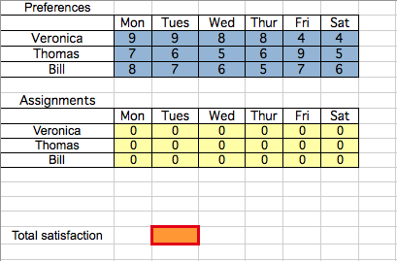
Create in Excel
Create this in Excel yourself where blue is preference data, yellow is binary decision variable, orange is objective

Slide 43
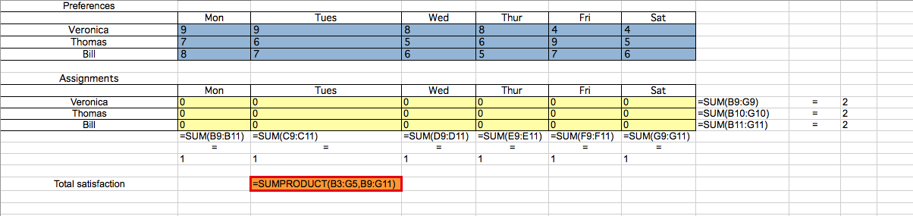
Add the Constraints

Slide 44
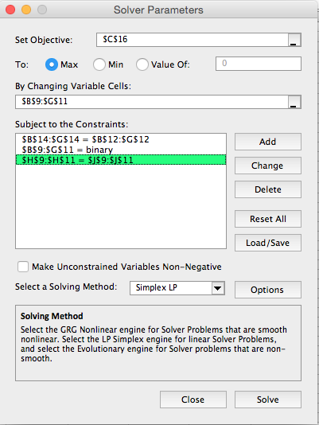
Setup Solver
• Fill out the necessary information in solver

Slide 45
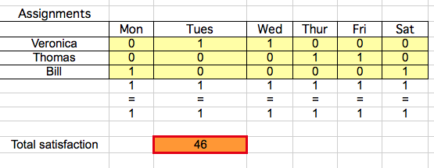
Solution
• Make sure Solver is labeled as Simplex LP!
• Once you hit solve, Solver will calculate and fill the objective cell
• Veronica will work Tuesday & Wednesday, Thomas Thursday &
Friday, Bill Monday & Saturday

Slide 46
Acknowledgement
Ilan Lobel
Assistant Professor in Operations Management
@ Stern IOMS

